Slide 1

INSTITUTE :UIE
DEPARTMENT: ALL ACADEMIC UNITS
Bachelor of Engineering (All Sections)
Subject Name and Code:
Engineering Physics 23SPH-141
Prepared by: Ms. Arminder
UNIT 3
Introduction to Nanotechnology & Quantum Computing
DISCOVER . LEARN . EMPOWER

Slide 2
COURSE OBJECTIVES
The course is designed to make the students industry ready to contribute in the growing demand of the industry at local, national and international level.
It will make the students competent to understand basic concepts and applications of advanced engineering physics and apply its principles in their respective fields at global platform.
It will enhance the skill level of the students and shall make them preferred choice for getting employment in industry and research labs.
It will give thorough knowledge of the discipline to enable students to disseminate knowledge in pursuing excellence in academic areas.

Slide 3

COURSE OUTCOME
CO Number | Title On completion of this course, the students are expected to learn | Level
CO1 | Quote the basic fundamental concepts of lasers, optical fibres, crystallography, ultrasonic oscillations, semiconductor physics, quantum mechanics and nanotechnology. | Remember, Understand
CO2 | Demonstrate the working of various lasers, fibre components, semiconductor devices; explain the behaviour of crystalline solids, quantum and nano-scale systems. | Understand
CO3 | Solve problems by applying principles related to lasers, fibres, semiconductors, oscillations, quantum and nanoscience. | Applying
CO4 | Compare various lasers and fibres, semiconducting devices, crystalline materials, structures at quantum and nanoscale on the basis of their properties for industrial applications. | Analyze
CO5 | Develop various systems using lasers, fibres, semiconductors and nanomaterials for futuristic applications. | Design

Slide 4
LECTURE OBJECTIVE
Students will learn about properties of nanomaterials
Students will understand about types of nanomaterials.
Students will learn about example related to previous mentioned topic.

Slide 5
CONTENT
Quantum well
Quantum wire
Quantum dot
Properties
Surface to volume ratio
Quantum confinement

Slide 6
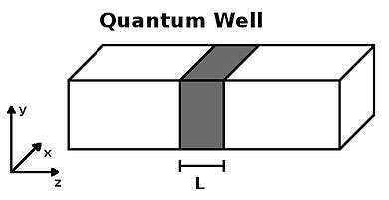
QUANTUM WELL
If one dimension is reduced to the nano-range while the other two dimensions remain large, then we obtain a structure known as quantum well. This reduction in dimension produces confinement of the electrons
Figure 1: Squeezing one length into nano-meter [1]

Slide 7
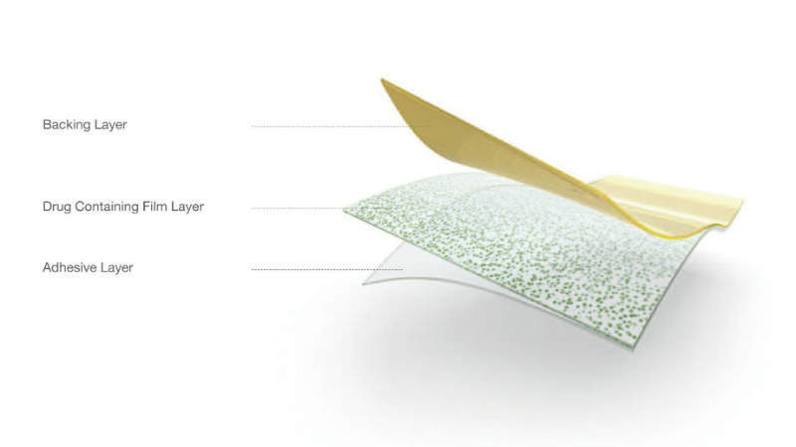
QUANTUM WELL
Figure 2: Quantum well- thin film [2]

Slide 8
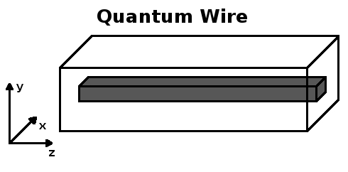
QUANTUM WIRE
If two dimensions are reduced (confined) and one remains large, the resulting structure is referred to as a quantum wire
Figure 3: Squeezing 2 dimensions into nano sizes [3]

Slide 9
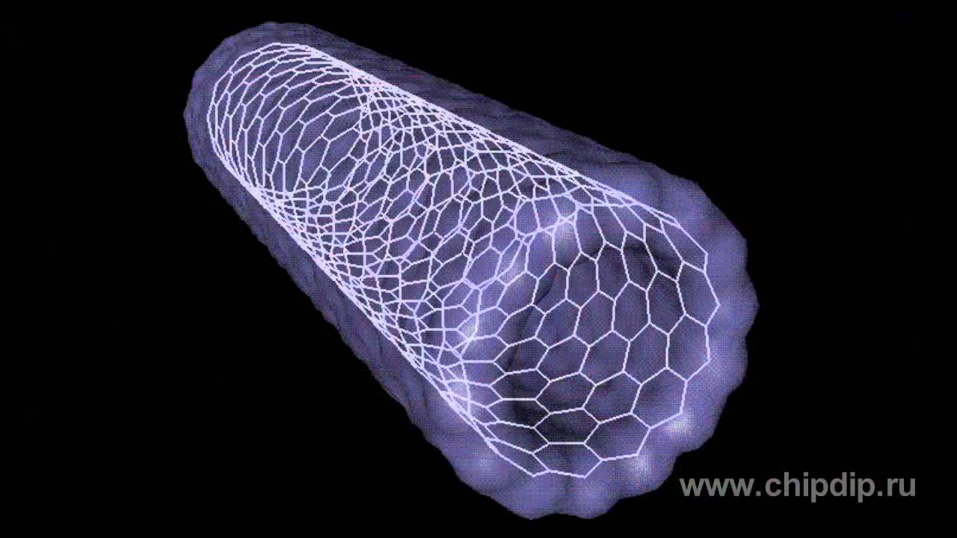
QUANTUM WIRE
Figure 4: Carbon nanotube [4]

Slide 10
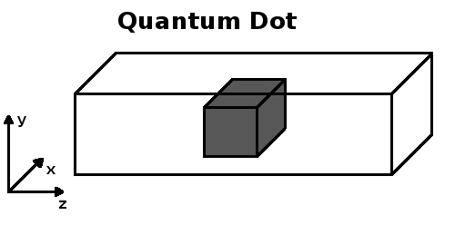
QUANTUM DOT
The reduction or the confinement in all three dimensions is called a quantum dot.
Figure 5: Squeezing all three dimensions in nano sizes [5]

Slide 11
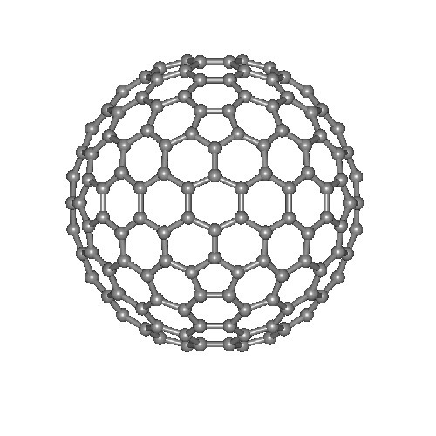
FULLERENE
Figure 6: Fullerenes [6]

Slide 12
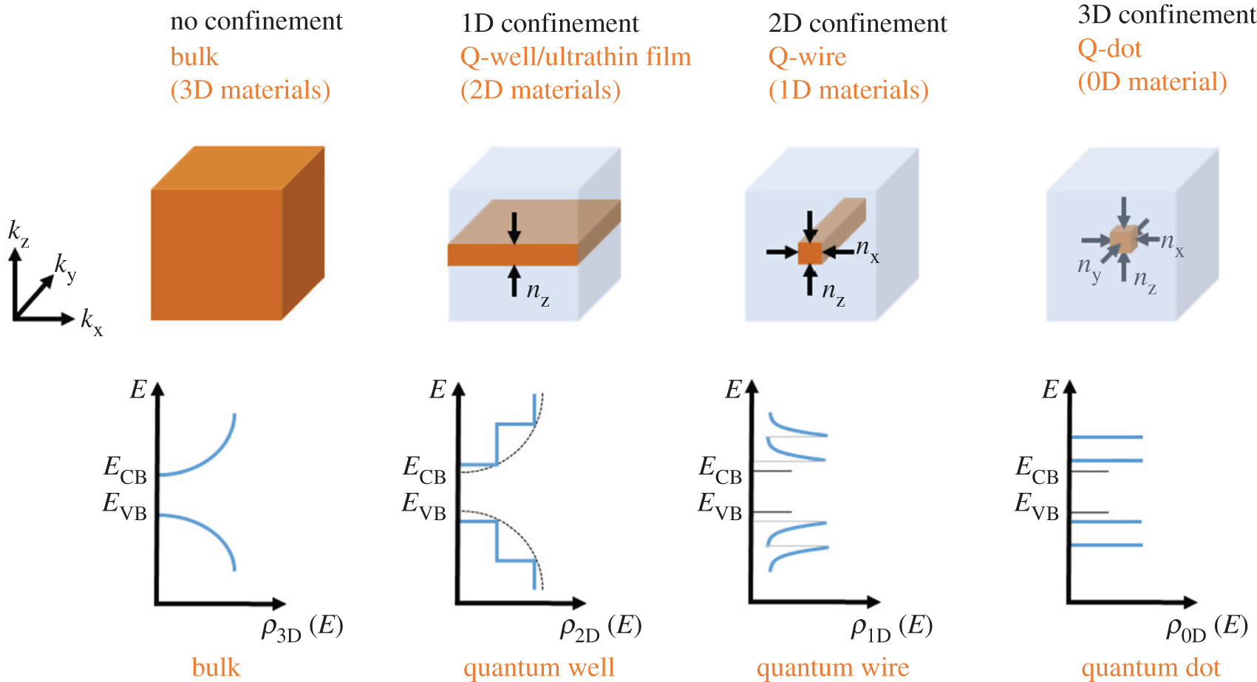
TYPES OF NANOMATERIALS
Figure 7: Classification of nanomaterials on the basis of dimensions [7]

Slide 13
SURFACE TO VOLUME RATIO
For example, let us consider a sphere of radius r .
The surface area of the sphere will be 4πr ²
The volume of the sphere = 4/3πr ³
Therefore the surface area to the volume ratio will be 4πr ² /(4/3πr ³ ) = 3/r
It means that the surface area to volume ratio increases as the radius of the sphere decreases and vice versa

Slide 14
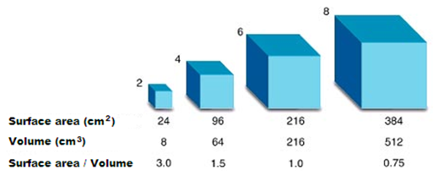
SURFACE TO VOLUME RATIO
Figure 8: Increasing surface to volume ratio from bulk to nano size [8]

Slide 15
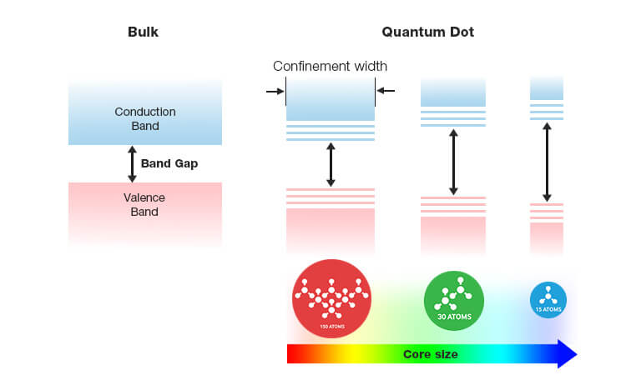
QUANTUM CONFINEMENT
Electron confinement or quantum confinement is another process that occurs in nanoparticles. We know that when atoms are isolated, then their energy levels are discrete but when they are in packed form and in large numbers (in solid form), the energy levels split and form bands (band means group of levels). Nanoparticles represents intermediate stage.
Figure 9: Increasing band gap as size decreases [9]

Slide 16
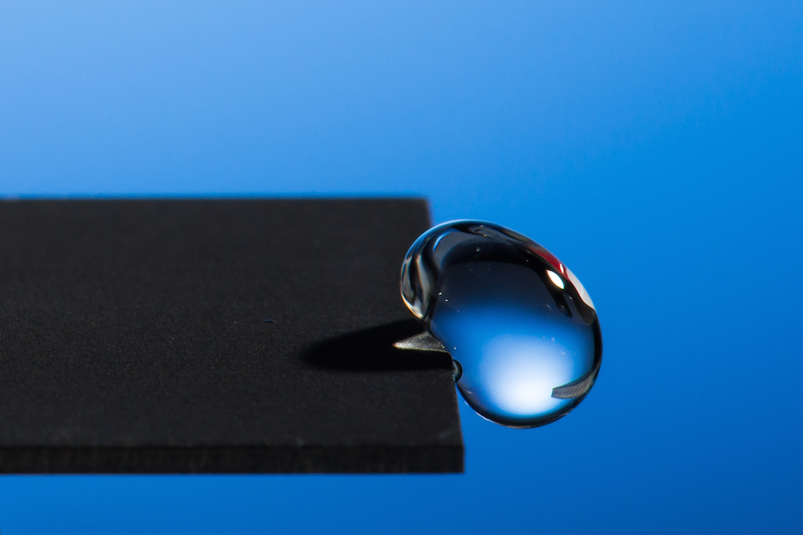
Achieving superhydrophobic/antibiofouling surfaces
Nanoscale surface roughness enhances material properties like hydrophilicity or hydrophobicity, which is otherwise unattainable (by exploring different materials). The phenomenon of super hydrophobicity relies on achieving Cassie Baxter state (allowing support of water droplet on nano-roughness, without actually wetting the entire surface).
Figure 10: Water bounces off from water repellent surface [10]

Slide 17
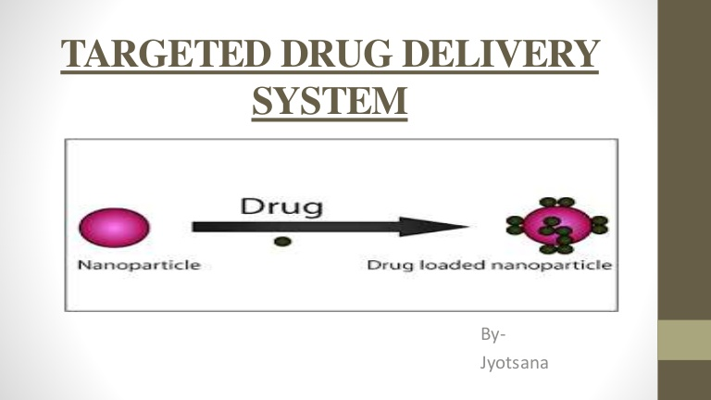
TARGETED DRUG DELIVERY
Nanoparticles can be loaded with specific sensor and drug molecule(s). The drug can be transported to the required site through blood stream. On detection of the affected tissue/cells/area by the functionalized surface group the drug is released locally on desired target (targeted drug delivery).
Figure 11: Target drug delivery system [11]

Slide 18
SUPERPARAMAGNETIC
Ferromagnetic materials consist of magnetic domains within which the spins are parallel. When the particle size is reduced to very small sizes (typically less than 20 nm) the entire particle becomes a single domain. On further reduction in size (about less than 5 nm) the spins get thermally disordered in the absence of magnetic fields. When an external magnetic field is applied the spins are able to align in the direction of applied magnetic field, making them behave as super paramagnets (i.e., in the absence of external field the particle is paramagnetic and in the presence of a field all the spins are aligned in parallel, leading to a large increase in magnetization). This is an interesting example in which a ferromagnetic material in bulk behaves like a paramagnet when particle size is made very small.

Slide 19
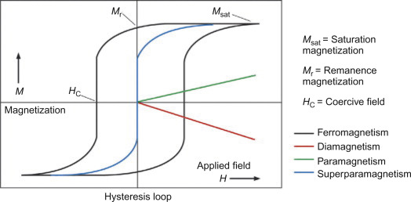
SUPERPARAMAGNETIC
Figure 12: Hysteresis curve for different magnetic materials [12]

Slide 20
SUMMARY
Nanomaterials can be used to produce giant magnets
Nano materials behave like super hydrophobicity.
They behave like super paramagnetic.
They can use a target medicines to many deceases.
They help in making water resistant surfaces, non-wetting cloths.
If one dimension is reduced to the nano-range while the other two dimensions remain large, then we obtain a structure known as quantum well.
If two dimensions are reduced (confined) and one remains large, the resulting structure is referred to as a quantum wire.
The confinement in all three dimensions is called a quantum dot.

Slide 21
FAQ
Differentiate nanomaterials on the basis of confinement of dimensions.
Enlist some properties of nano materials.
Explore the term quantum confinement. How it effects properties of nano materials?
How surface to volume ratio increases with decrease in size?

Slide 22
REFERENCES
https://www.hindawi.com/journals/bmri/2014/498420/
https://link.springer.com/chapter/10.1007/978-3-319-09171-6_8
https://www.circuitstoday.com/nanomaterials
https://maken.wikiwijs.nl/bestanden/427519/Lesson_7_APPENDIX-2_Article2.pdf
https://www.sciencedirect.com/science/article/pii/S1878535217300990

Slide 23
IMAGES REFERENCES
[1]https://www.edn.com/thick-and-thin-quantum-wells-dramatically-affect-cyan-led-bandwidth/
[2]https://www.pharmaceutical-business-review.com/products/oral-thin-films-drug-delivery/
[3] https://commons.wikimedia.org/wiki/File:Quantum_wire.jpg
[4] https://www.youtube.com/watch?v=wsWD5dJv2OE
[5]https://commons.wikimedia.org/w/index.php?search=quantum+dot&title=Special%3ASearch&go=Go&ns0=1&ns6=1&ns12=1&ns14=1&ns100=1&ns106=1#/media/File:Quantum_dot_schema.jpg

Slide 24
IMAGES REFERENCES
[6]https://www.indiamart.com/proddetail/carbon-fullerenes-13710958673.html
[7]https://www.google.com/imgres?imgurl=https%3A%2F%2Froyalsocietypublishing.org%2Fcms%2Fasset%2Fd1f6569c-4733-4709-97f0-8074b307a9ce%2Frsos180387f01.jpg&imgrefurl=https%3A%2F%2Froyalsocietypublishing.org%2Fdoi%2F10.1098%2Frsos.180387&tbnid=15vtPUvfbCUcXM&vet=12ahUKEwiY4ZSriJDrAhUTYysKHR5SCbMQMygEegUIARCwAQ..i&docid=NkQ_AsDwWmCS1M&w=1701&h=923&q=quantum%20confinement%20effect&ved=2ahUKEwiY4ZSriJDrAhUTYysKHR5SCbMQMygEegUIARCwAQ

Slide 25
IMAGES REFERENCES
[8]https://www.pathwayz.org/Tree/Plain/SURFACE+AREA+TO+VOLUME+RATIO
[9] https://pid.samsungdisplay.com/en/learning-center/white-papers/guide-to-understanding-quantum-dot-displays
[10] https://www.livescience.com/49515-water-repellent-material.html
[11] https://www.slideshare.net/JigyashaBhatt/targeted-drug-delivery-system-94064136
[12]https://www.sciencedirect.com/science/article/pii/B9780128137413000388

Slide 26
REFERENCES
Video link
https://www.youtube.com/watch?v=RvtlBh_-_Rw
https://www.youtube.com/channel/UCa1LT1sfzVGP6grvbfcqUjQ
https://www.youtube.com/watch?v=5lvjo0rm-F0
https://www.youtube.com/watch?v=WElm-VglY7s
Books
Sahni V., Goswami D. (2008) Nano Computing, McGraw Hill Education Asia Ltd., ISBN: 978007024892Beiser A., Ghatak A, Garg S.C., Applied Physics, Edition 1st, (2013), Tata McGraw-Hill, Noida.

Slide 27
THANK YOU
For queries
Email: arminder.uis@cumail.in

